Slide 1
Magnetic Forces on Moving Charges

Slide 2
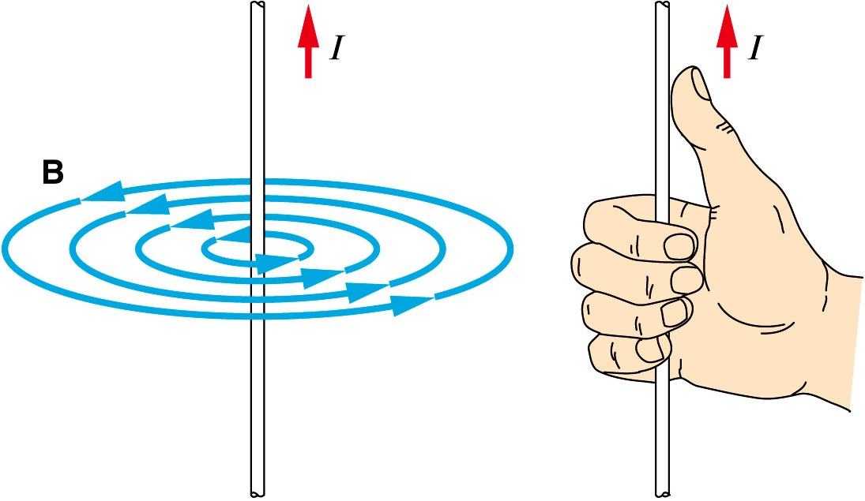
Review: Current Carrying Conductors
Magnetic fields can be produced by the movement of charged particles – usually electrons in wires.
The simplest example of this is a single straight wire, which produces a magnetic field of concentric circles when current flows through it.
The direction of these field lines can easily be predicted using the right hand rule.
Note that:
I here is the direction of conventional current (positive to negative), not electron flow.
This is not a dipole field.
So what happens when this wire enters a different magnetic field?

Slide 3
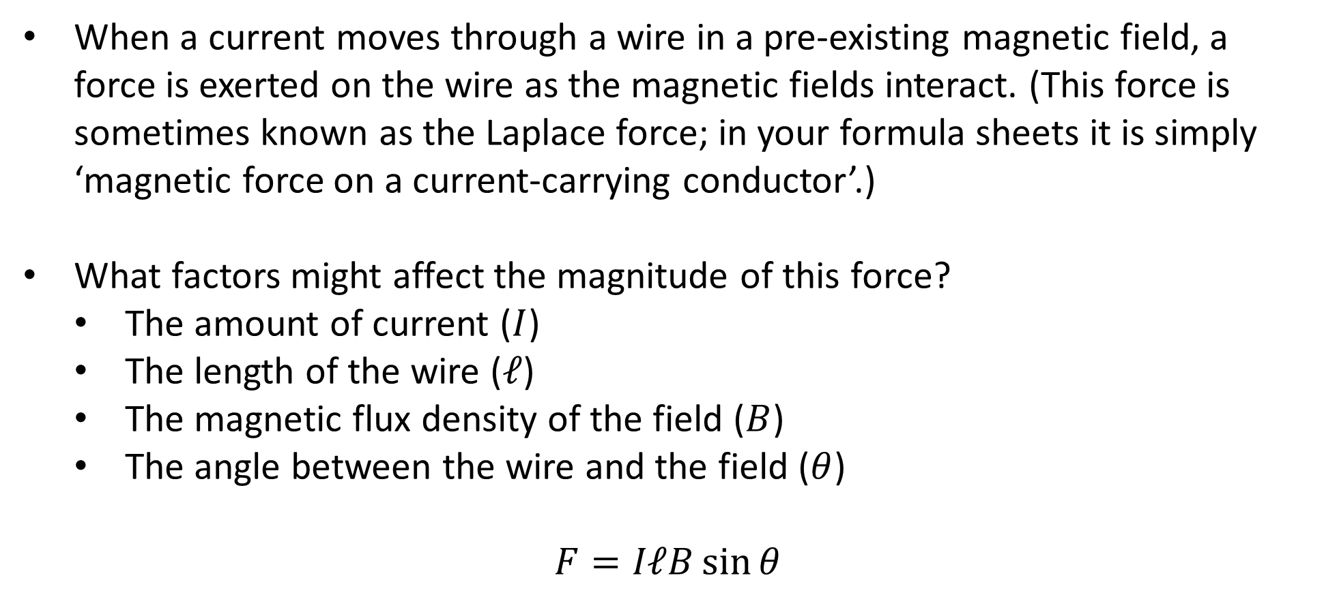
Magnetic Force on Currents
When a current moves through a wire in a pre-existing magnetic field, a force is exerted on the wire as the magnetic fields interact. (This force is sometimes known as the Laplace force; in your formula sheets it is simply ‘magnetic force on a current-carrying conductor’.)
What factors might affect the magnitude of this force?
The amount of current ($I$)
The length of the wire ($ℓ$)
The magnetic flux density of the field ($B$)
The angle between the wire and the field ($θ$)
$$F=IℓB\sin{θ}$$
Notes:
Any charged particle moving through an electric and/or magnetic field experiences a force (known as the Lorentz force) based on the strengths of the fields. The force mentioned here is simply the sum of Lorentz forces on the electrons in a current-carrying conductor, ignoring the effects of any electric fields.
You may sometimes see this formula written as $F=BIL\sin{θ}$. As we’re about to see, this is somewhat unhelpful.

Slide 4
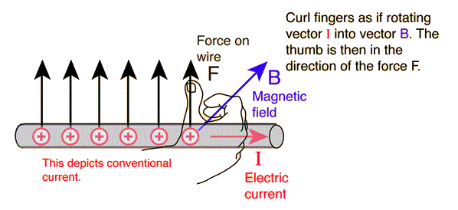

Magnetic Force on Currents
Determining the direction of this force requires the use of the right hand rule again:
Helpfully, the equation ($F=IℓB\sin{θ}$) lists the two vectors in this order.
$$IℓB$$
$$I \text{to} B$$
Notes:
Make sure you’re using arrows that are coming out of the wire, not going into it!
Strictly speaking, the force is $F=Iℓ×B$: a cross product (vector product).

Slide 5
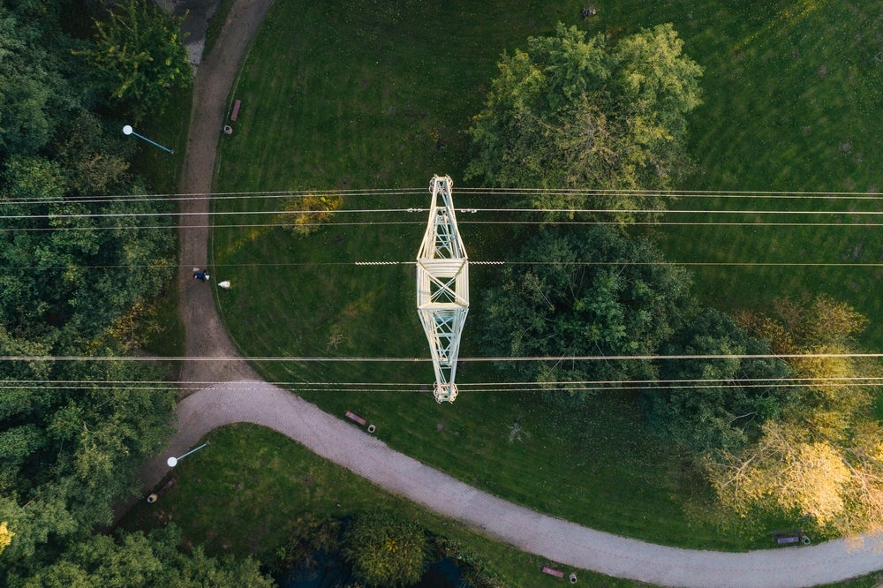
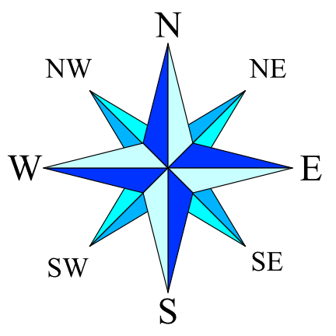
Example #1
A 700 A current is running from west to east through the power line shown in the photo below. Assuming that it is near the equator, determine the:
Direction of the magnetic force on the power line.
Magnitude of the magnetic force on 1 m of the power line if the Earth’s magnetic flux density in this region is 5.00 × 10⁻⁵ T.

Slide 6
Example #2
Two parallel wires have currents flowing through them in opposite directions. With the help of a diagram/s, determine whether the two wires would experience an attractive or a repulsive force. (Hint: consider one field at a time.)

Slide 7
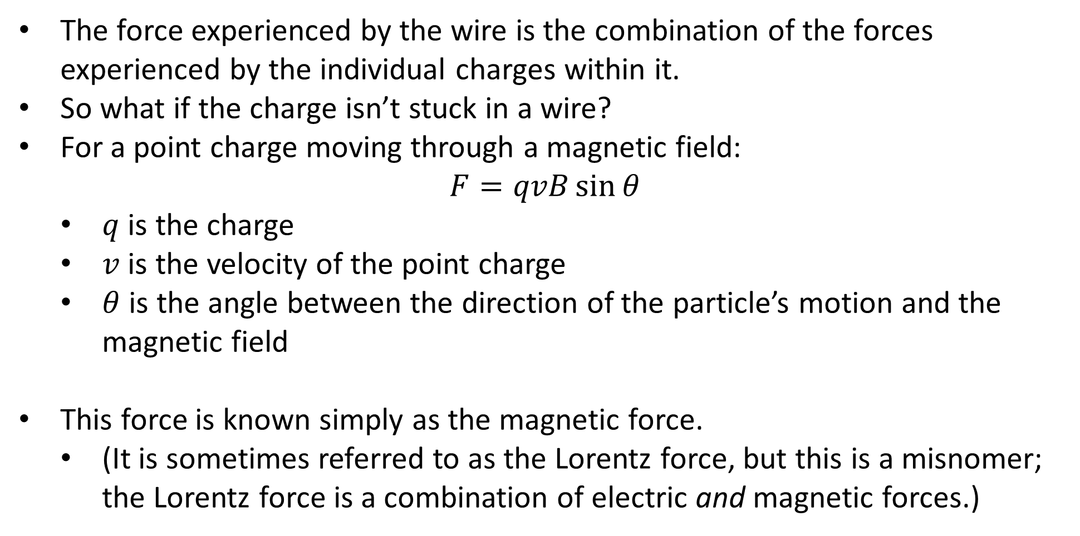
Magnetic Force on Particles
The force experienced by the wire is the combination of the forces experienced by the individual charges within it.
So what if the charge isn’t stuck in a wire?
For a point charge moving through a magnetic field:
$$F=qvB\sin{θ}$$
$q$ is the charge
$v$ is the velocity of the point charge
$θ$ is the angle between the direction of the particle’s motion and the magnetic field
This force is known simply as the magnetic force.
(It is sometimes referred to as the Lorentz force, but this is a misnomer; the Lorentz force is a combination of electric and magnetic forces.)

Slide 8
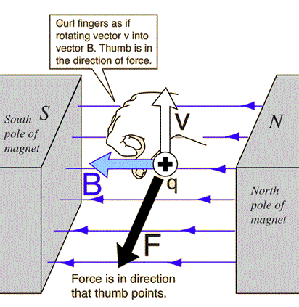
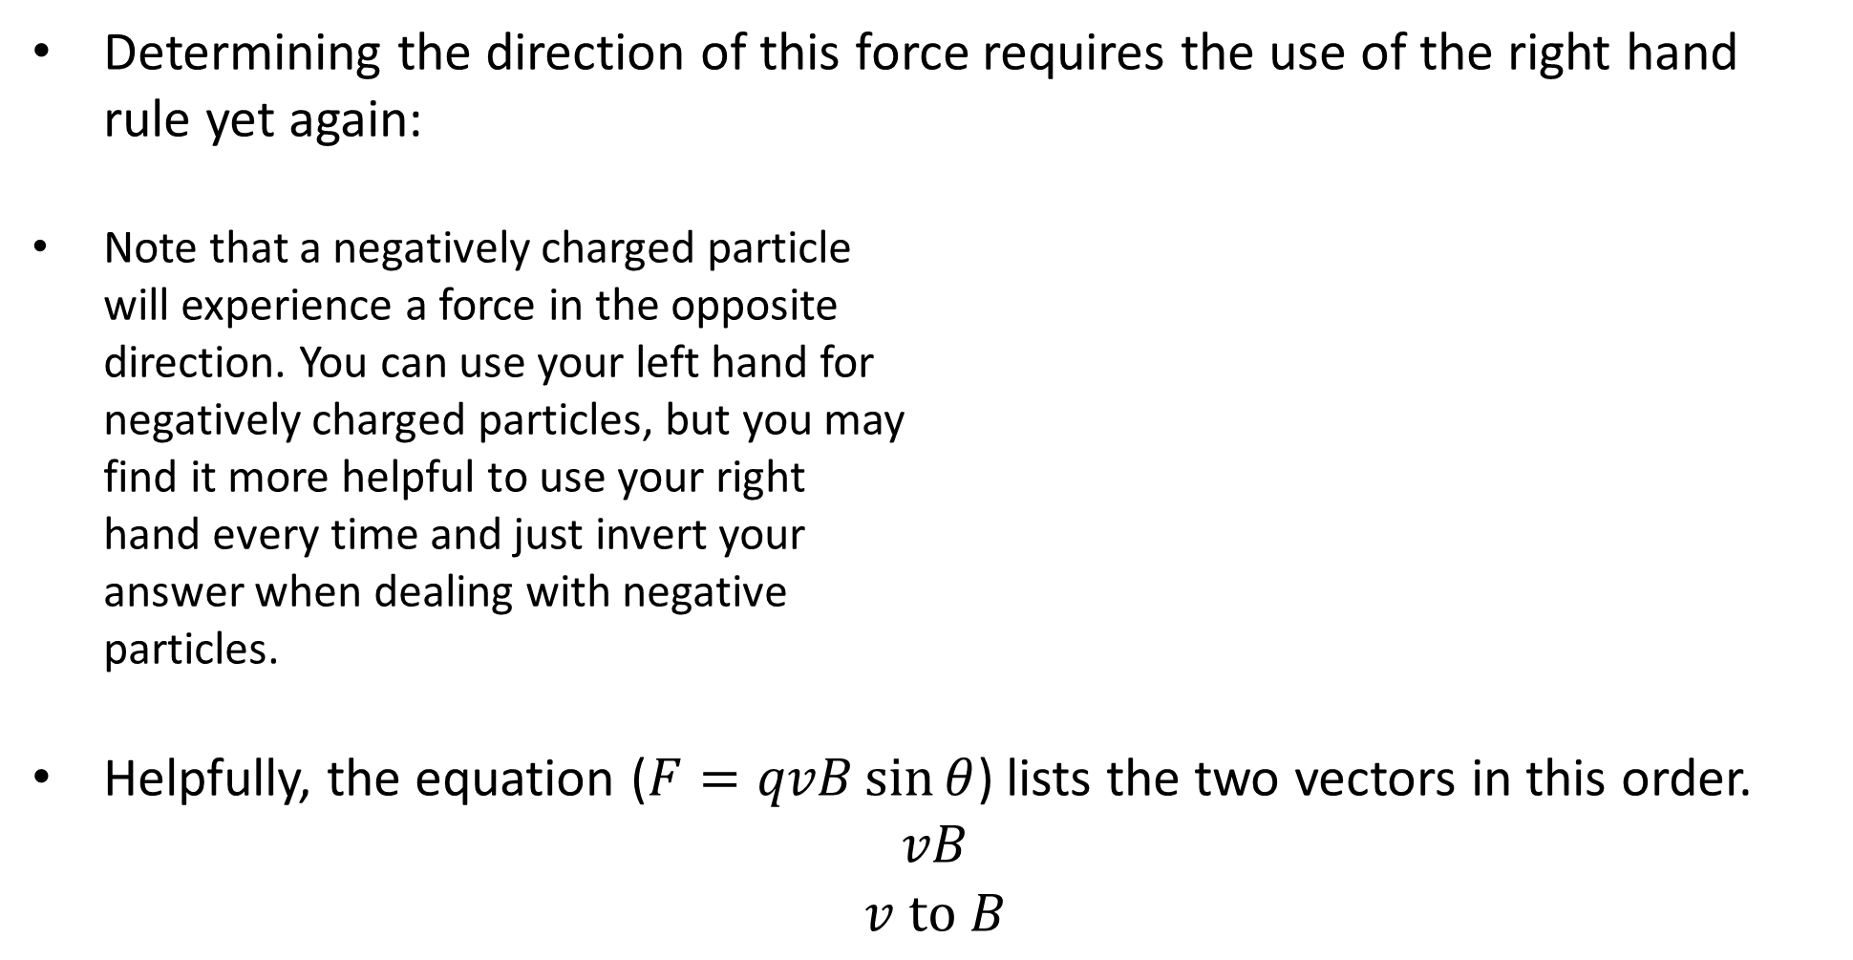
Magnetic Force on Particles
Determining the direction of this force requires the use of the right hand rule yet again:
Note that a negatively charged particle will experience a force in the opposite direction. You can use your left hand for negatively charged particles, but you may find it more helpful to use your right hand every time and just invert your answer when dealing with negative particles.
Helpfully, the equation ($F=qvB\sin{θ}$) lists the two vectors in this order.
$$vB$$
$$v \text{to} B$$

Slide 9
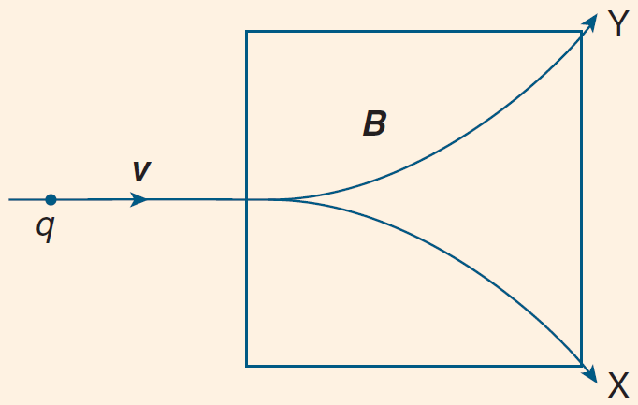
Example #3
The diagram below shows a particle with charge q entering a uniform magnetic field of flux density B. The initial velocity, v, of the particle is perpendicular to the field. Which of the following combinations would result in the particle following path X?
q is positive, B is into the page.
q is negative, B is out of the page.
q is positive, B is out of the page.
q is negative, B is into the page.
Which of the combinations above would result in the particle following path Y?

Slide 10
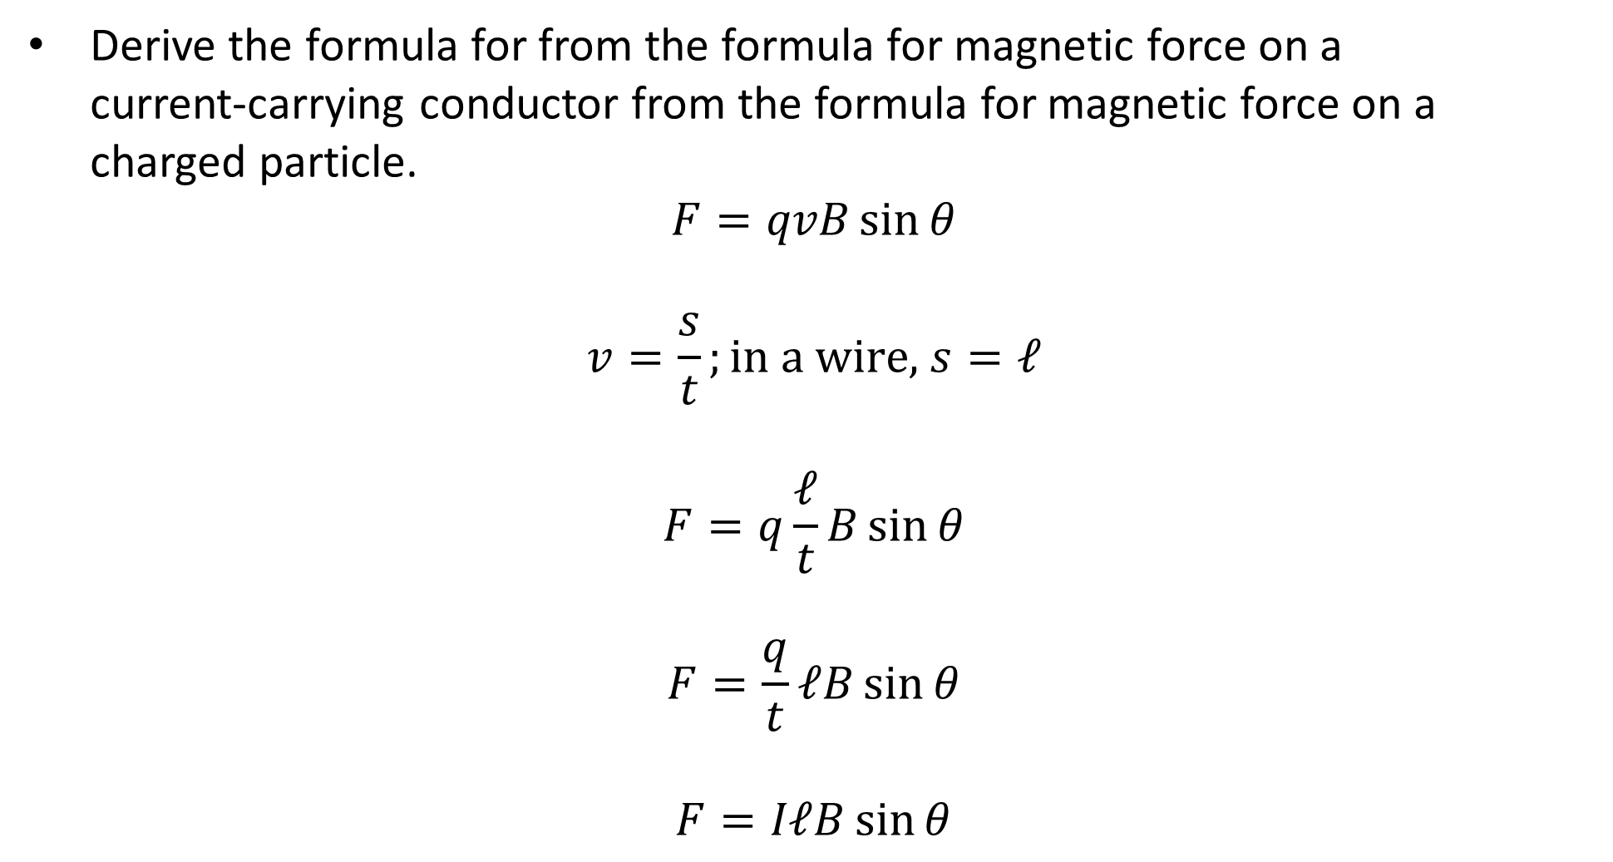
Example #4
Derive the formula for from the formula for magnetic force on a current‑carrying conductor from the formula for magnetic force on a charged particle.
$$F=qvB\sin{θ}$$
$$v=\frac{s}{t};\text{in} \text{a} \text{wire}\text{, }s=ℓ$$
$$F=q\frac{ℓ}{t}B\sin{θ}$$
$$F=\frac{q}{t}ℓB\sin{θ}$$
$$F=IℓB\sin{θ}$$

